Slide 1
Bird detection and tracking from camera videos
CSC 8980 – Final Project
Presented by
S M Towhidul Islam

Slide 2
Objective
Realtime bird detection is important in several important applications such as aviation safety, wildlife surveillance, agricultural bird control and so on. In this project, I aim to detect birds from stationery camera videos and track the movement.

Slide 3
Bird Detection Framework
Input Video Frames
Apply noise removal and convert to binary image
Separate foreground from background
Keep only shapes of interest, that is those shapes
that potentially represent birds
Background Modeling
Foreground Extraction
Shape based filtering
Output Frame

Slide 4
Bird Tracking Framework
Foreground frames
Predict next position of the detected region using
Kalman filter
Based on the current frame, create/update/delete
tracks from the previous frame
Based on the result, visualize the detection and
tracking result on video frames
Predict motion of the object (Kalman filter)
Motion Track (Create/Update/Delete)
Visualize on original frame
Output Frame

Slide 5
Implementation - Detection
Foreground detection:
detector = vision.ForegroundDetector('NumGaussians', 3, 'NumTrainingFrames', 40, 'MinimumBackgroundRatio', 0.7);
detector.step(frame);
Find moving regions:
vision.BlobAnalysis('BoundingBoxOutputPort', true, 'AreaOutputPort', true, 'CentroidOutputPort’, true,
'MinimumBlobArea', 1600);
Tracking of moving regions:
struct('id', {},'bbox', {}, 'kalmanFilter', {}, 'age', {}, 'totalVisibleCount', {},
'consecutiveInvisibleCount', {});

Slide 6
Implementation - Tracking
Configure Kalman Filter:
kalmanFilter = configureKalmanFilter('ConstantVelocity',centroid, [200, 50], [100, 25], 100);
(MotionModel,InitialLocation,InitialEstimateError,MotionNoise,MeasurementNoise)
Predict current location of a track:
predictedCentroid = predict(tracks(i).kalmanFilter);
Choosing reliable tracks:
reliableTrackInds = [tracks(:).totalVisibleCount] > minVisibleCount;
Update tracks:
correct(tracks(trackIdx).kalmanFilter, centroid);

Slide 7
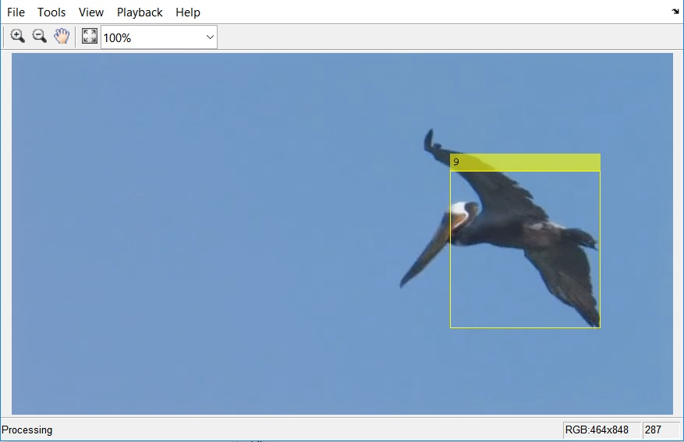
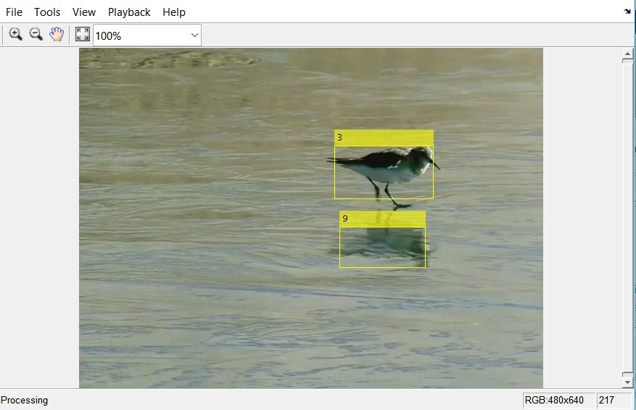
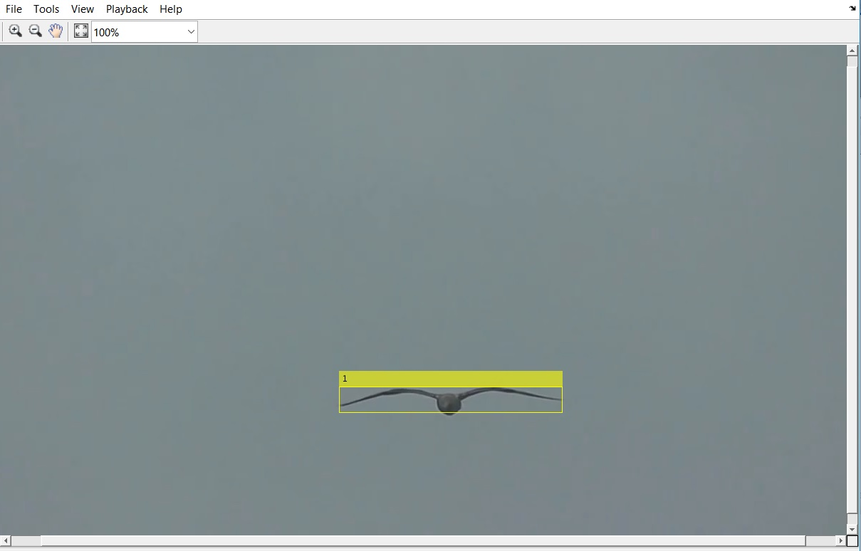
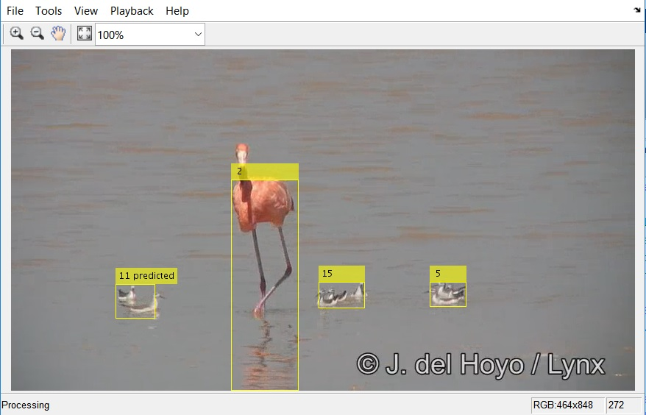
Results
Results based on different input videos

Slide 8
References
Qunyu Xu and Xiaofeng Shi (2014). A simplified bird skeleton based flying bird detection. Proceeding of the 11th World Congress on Intelligent Control and Automation.
2. Li, Y., Yin, Y. and Xu, B. (2009). Bird Objects Detection and Tracking on the Wild Field Circumstance. 2009
WRI World Congress on Computer Science and Information Engineering.
3. Zhang, X., Wu, X., Zhou, X., Wang, X. and Zhang, Y. (2008). Automatic Detection and Tracking of
Maneuverable Birds in Videos. 2008 International Conference on Computational Intelligence and Security.
4. Shakeri, M. and Zhang, H. (2012). Real-time bird detection based on background subtraction. Proceedings of the
10th World Congress on Intelligent Control and Automation.
Motion-Based Multiple Object Tracking, https://www.mathworks.com/help/vision/examples/motion-based-multiple-object-tracking.html
http://arma.sourceforge.net/vb100/

